Slide 1
Financial Aid

Slide 2
What is Financial Aid?
Financial aid consists of funds provided to students and families to help pay for postsecondary educational expenses.

Slide 3
Sources of Financial Aid
Federal Government
Employers
States
Private Sources
College and Universities

Slide 4
How to Apply for Financial Assistance

Slide 5
FSA ID
An FSA ID gives you access to Federal Student Aid’s online systems and serve as your legal signature.
Both the student AND a parent need to create one.
Will be used throughout the aid process, including subsequent years.
http://studentaid.gov/

Slide 6
Free Application for Federal Student Aid (FAFSA)
MUST be filled to receive federal aid
  Required for some state and institutional as well
A standard federal form that collects demographic and financial information about student and family
May be filed at any time during an academic year, but no earlier than the October 1st prior to the academic year for which the student requests aid

Slide 7
FAFSA Changes
July 1, 2023
  2023-2024 Academic year
FAFSA opens October 1, 2022
Reduced to 36 questions
Replace EFC with Student Aid Index (SAI)
  More equitable formula
Makes it easier for families to estimate SAI
Parent that claim student on Taxes will be on FAFSA
Notes:
Reduced from 108

Slide 8




Ways to file the FAFSA
FAFSA on the Web (FOTW)
myFAFSA via myStudentAid mobile app
Paper (PDF) FAFSA
FAA Access to CPS Online
FAFSA on the Phone (FOTP)

Slide 9
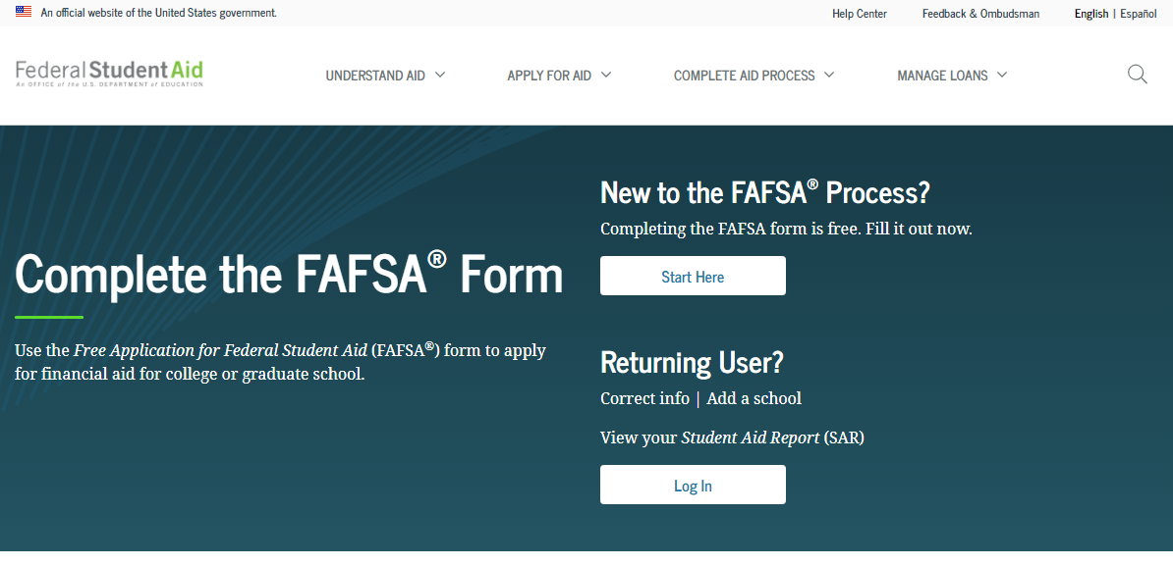
Free Application for Federal Student Aid (FAFSA)
Website: https://studentaid.gov/h/apply-for-aid/fafsa

Slide 10
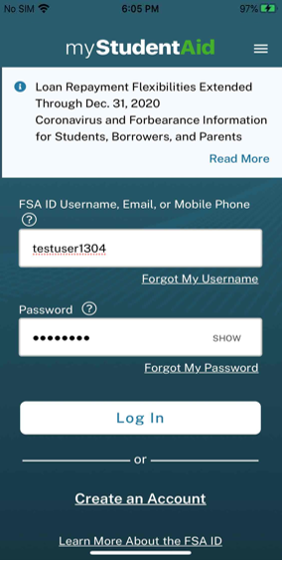
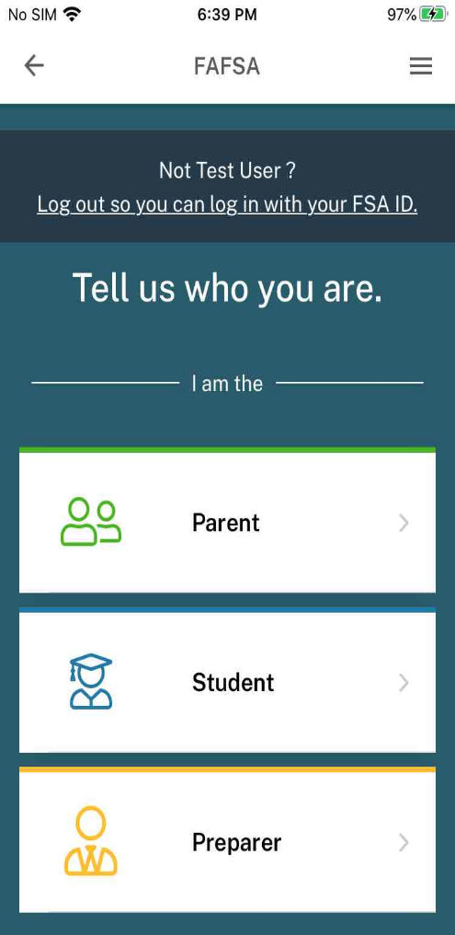
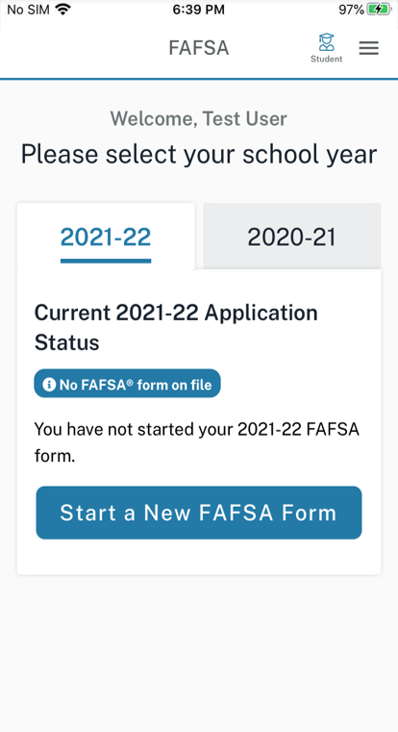
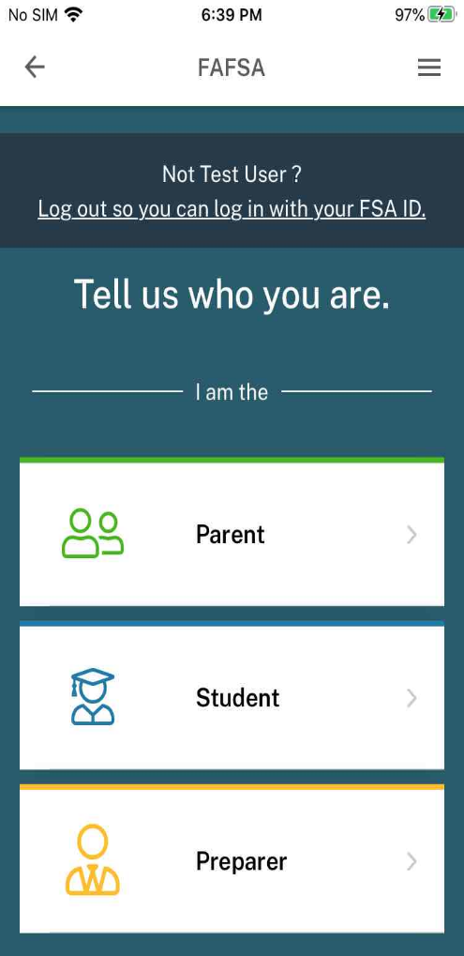
myStudentAid Mobile App
Welcome, Student
2022-23
2021-22
Current 2022-23 Application Status
You have not started your 2022-23 FAFSA form.
Notes:
Mobile ability to begin, complete, save, and submit the FAFSA

Slide 11
FAFSA: Prior-Prior Year
May be filed at any time during an academic year, but no earlier than October 1st prior to the academic year for which the student requests aid
Starting October 1, 2021, students can begin FAFSA for 2022-23 academic year using prior year info.
  2020 Tax Info

Slide 12
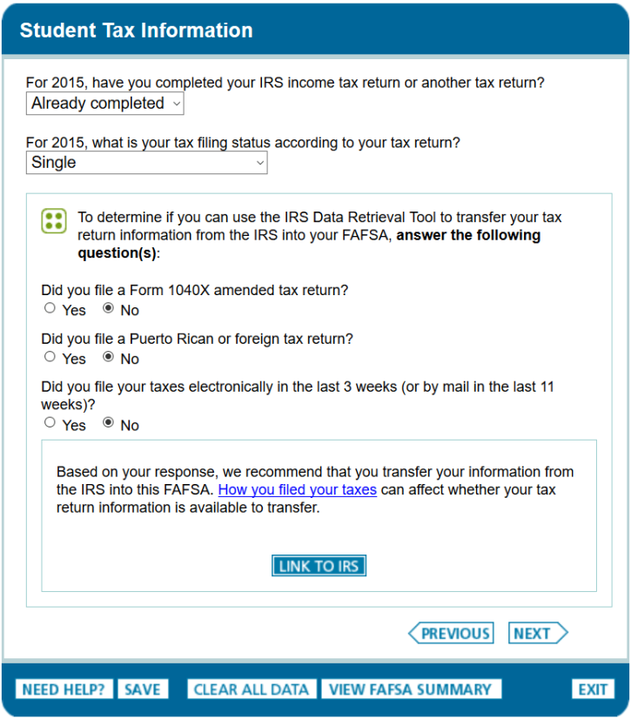
IRS Data Retrieval Tool (IRS DRT)
The IRS Data Retrieval Tool allows students and parents to access the IRS tax return information.
Transfer the data directly into their FAFSA from the IRS Web database.

Slide 13
Who’s data is entered?
Student
  Demographic
  Income if earned
Parent
  All parents in the household

Slide 14
How is all of this information used?

Slide 15
What is the Expected Family Contribution (EFC)?
Calculated by formula in FAFSA
Stays the same regardless of college
Amount a family can reasonably be expected to contribute per academic year of education

Slide 16
High Impact Information & EFC
Tax Info
  AGI, Taxes, Earnings
Current Financial Info
  Cash/Savings, Investments, Business/Farm income
Number in Household
  Number in College
Untaxed Income

Slide 17
CSS Profile
CollegeBoard Financial reporting
Used to determine need for institutional aid
Uses 2 years of financial data
  Includes private assets in EFC calculation
Fee for initial application and one college report is $25.
  Additional reports are $16
  Free to families making less thank $100k
Used by approx. 400 colleges and scholarship programs
  Only 3 in MD
Notes:
Hopkins University
Loyola University
St. Johns College

Slide 18
How do schools use this data?

Slide 19
What is Cost of Attendance (COA)?
Direct costs
  Tuition
  Fees
  Room
  Board
Indirect costs
  Books
  Transportation
  Personal Expenses
  Loan Fees
Cost of Attendance

Slide 20
What is Financial Need?
Cost of Attendance
Expected Family Contribution (EFC)
Financial Need

Slide 21
Categories of Aid
Need-based aid
Non-need-based aid

Slide 22
Types of Aid
Scholarships
Grants
Work-Study Employment
Loans
Self-Help Aid
Gift Aid

Slide 23
Main Sources of Aid

Slide 24
Institutional Funding
Scholarships
  Awarded for student achievement regardless of financial need
  Universities will have separate scholarship applications for the different colleges
Grants
  Need based funds offered to assist in covering CoA

Slide 25
State Funding
Can only be used for MD schools
Aid is awarded on the basis of both merit and need
FAFSA is required for most:
  March 1, 2022
For MD funding check Maryland Higher Education Commission (MHEC) www.mhec.state.md.us
  Legislative Scholarships
    www.mdelect.net
Undocumented/DACA students
  Maryland State Financial Aid Application (MSFAA)

Slide 26
Outside Scholarships
Scholarship search engines
  Fastweb
  Scholarships.com
  Cappex
  Scholly
  Niche
  Scholarship Monkey
Scholarships are everywhere

Slide 27
Loans

Slide 28
Loan Types
Stafford Loans
  Student Loans
    Subsidized
    Unsubsidized
  PLUS Loans (Parent)
Private Source Loans
  Banks
  Credit Unions
  Private Loan Servicer

Slide 29
Subsidized VS. Unsubsidized
Direct Subsidized Loans are available to undergraduate students with financial need.
Your school determines the amount you can borrow, and the amount may not exceed your financial need.
The U.S. Department of Education pays the interest on a Direct Subsidized Loan
  while you’re in school at least half-time,
  for the first six months after you leave school
  during a period of deferment
Direct Unsubsidized Loans are available to undergraduate and graduate students.
Your school determines the amount you can borrow based on your cost of attendance.
You are responsible for paying the interest on a Direct Unsubsidized Loan during all periods.
  If you choose not to pay the interest while you are in school and during grace periods, your interest will accrue and be capitalized

Slide 30
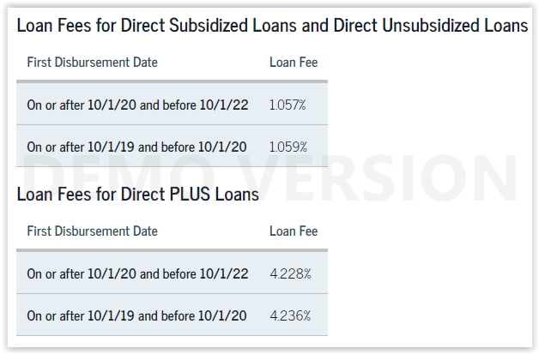
Loan fees change every year.
Example: 1.057%
$5500 loan fees= $58.13
Total amount credited to
your account= $5441.87

Slide 31
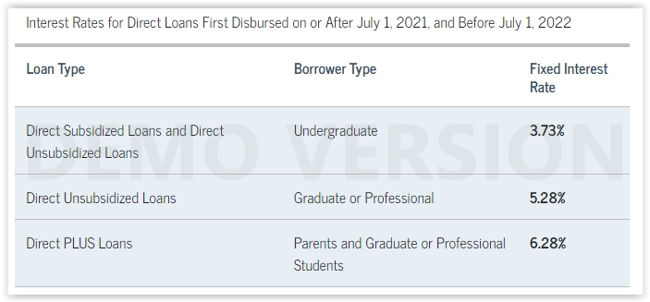
Rates for 2022 and beyond will change annually.
Interest rates are fixed for the life of the loan.

Slide 32
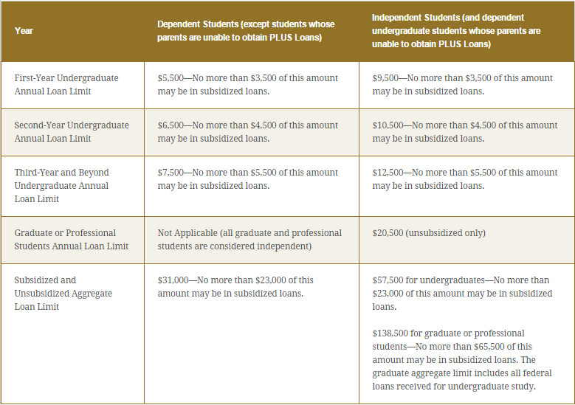

Slide 33
What else…

Slide 34
Special Circumstances
Conditions exist that cannot be documented with the FAFSA
Send written explanation and documentation to your college’s financial aid office
College will review and request additional information if necessary

Slide 35

Secondary school tuition
Unusual uncovered medical/dental expenses
Extraordinary dependent care
Parent or spouse death
Loss of employment
Divorce

Slide 36
Financial Aid Packages
Financial Aid Packages after admission notification
  Early Decision
    Early December
  Early Action Applicants
    Early January
  Regular Decision
    Early March
Will include (if eligible)
  Federal Grants
  State Grants
  Institutional Need Based Grants
  Institutional Scholarships
  Federal Loan options

Slide 37
Tools You Can use
Federal Student Aid
  https://studentaid.gov
Federal Student Aid Estimator
  Launching Sept. 26, 2021
  Help to get an idea of EFC/Need
  “College Cost Worksheet”
Net Price Calculators (NPC)
  Every Title IV school is required to have one

Slide 38
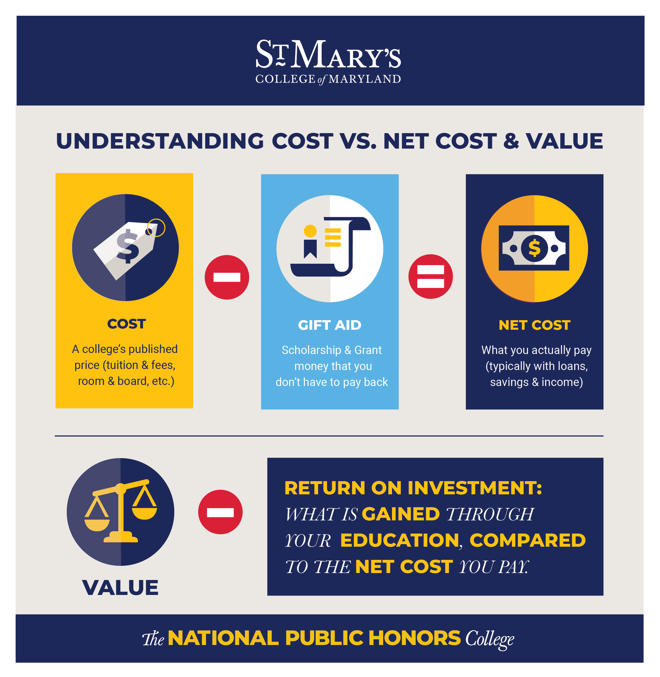

Slide 39
Questions?
Contact Info: www.smcm.edu/osfa osfa@smcm.edu

